Slide 1
International Student Assist
A simple path for international students
Marvin Battley, Paul Whitman, Louis Echefu, Libby Blair

Slide 2
International Student Assist is a web app for international students which provides links to all steps of applying to US universities and helps students have access to important documents
A one-stop app that provides a roadmap to guide students through applying and relocating to US universities

Slide 3
We formed this idea after speaking with some of our classmates, who are international students, about how and why they chose to pursue an education in the US
A common theme that arose is how many steps international students must go through to get here, and how difficult it is to navigate them

Slide 4
Purpose: to lead the way for all students to receive the quality education of their dreams, no matter their country of origin.

Slide 5
Values: Postsecondary education is one of the greatest investments of time and money that a person will ever make; Student opportunities should not be limited by the country they were born in

Slide 6
How will it work?
Our app will be web-based, and will walk the students through each step they need to complete in order to fulfill becoming a student at a university in the US
An example of what we feel the app will look like is presented in our next two slides

Slide 7
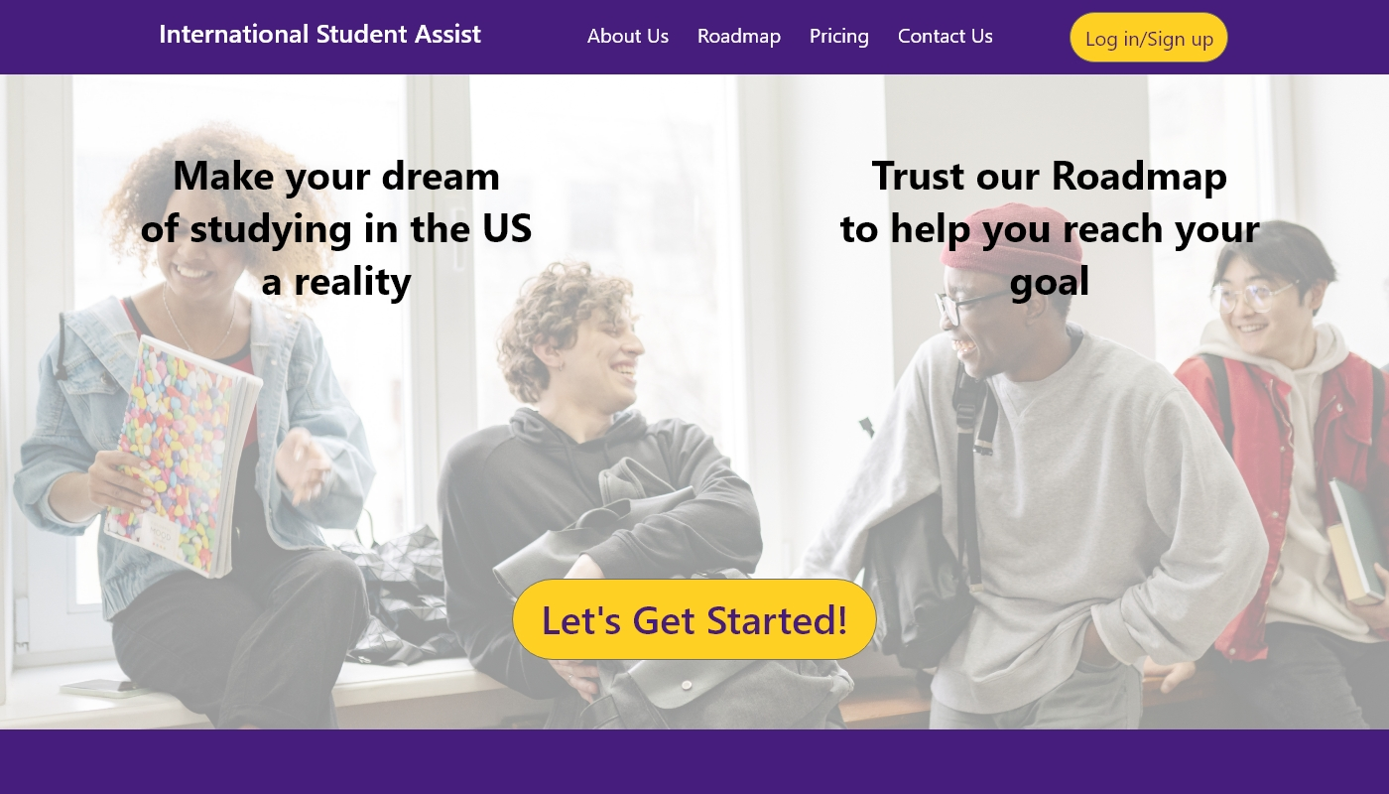

Slide 8
Features
Checklist
Website links
FAQs
Tips and Tricks

Slide 9
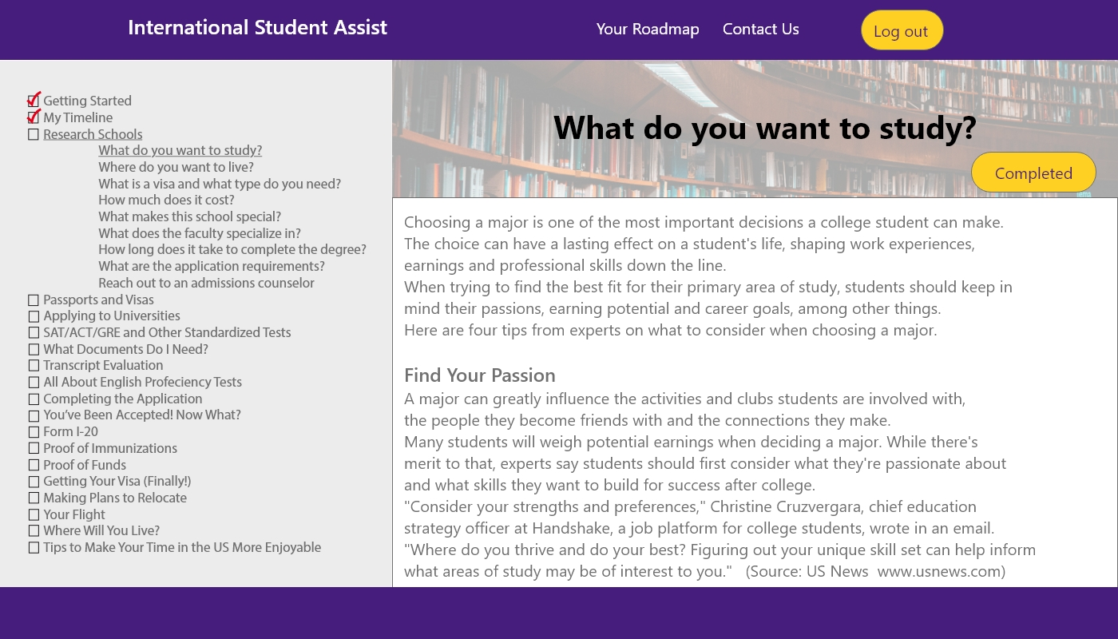

Slide 10
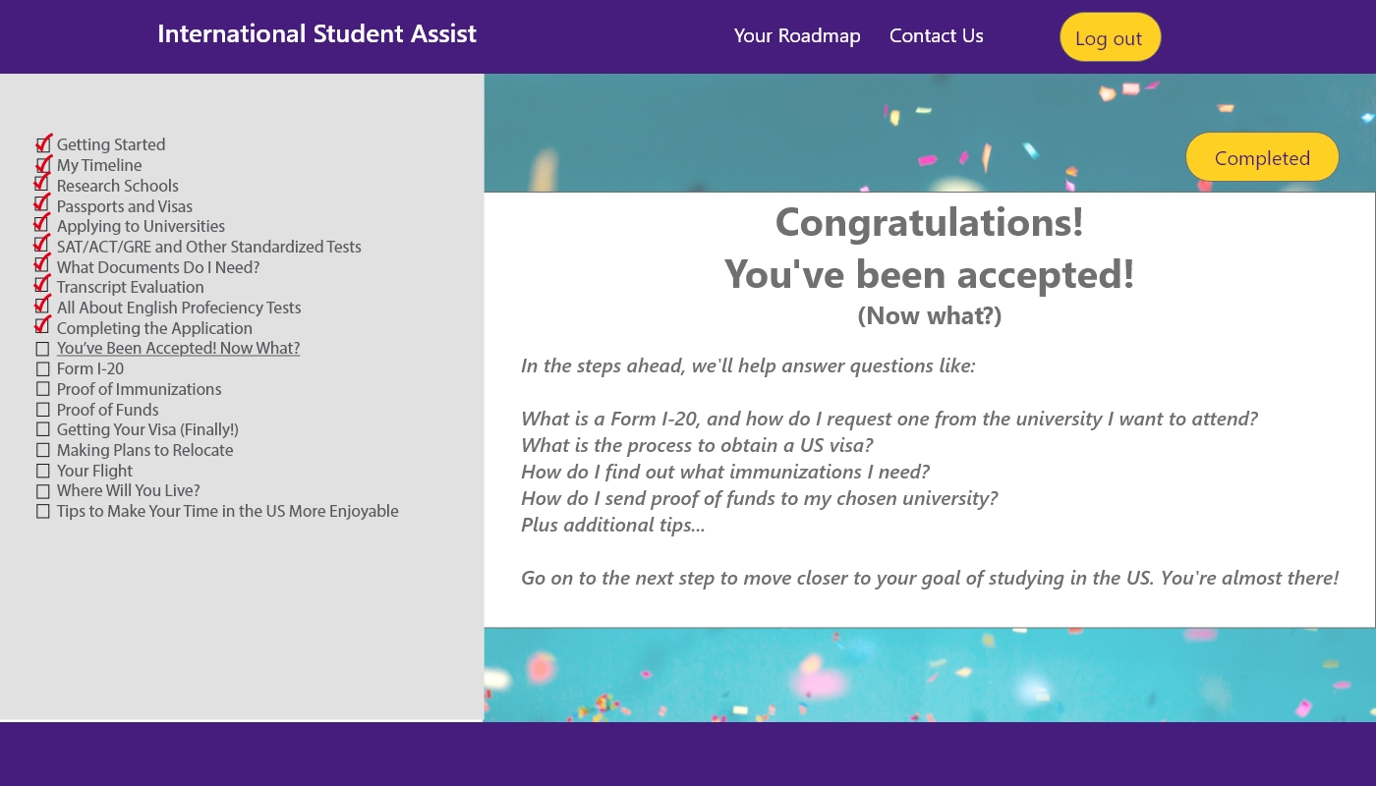

Slide 11
Systems we will use
JavaScript
AWS
GitLab
MySQL
React.js
Node.js

Slide 12
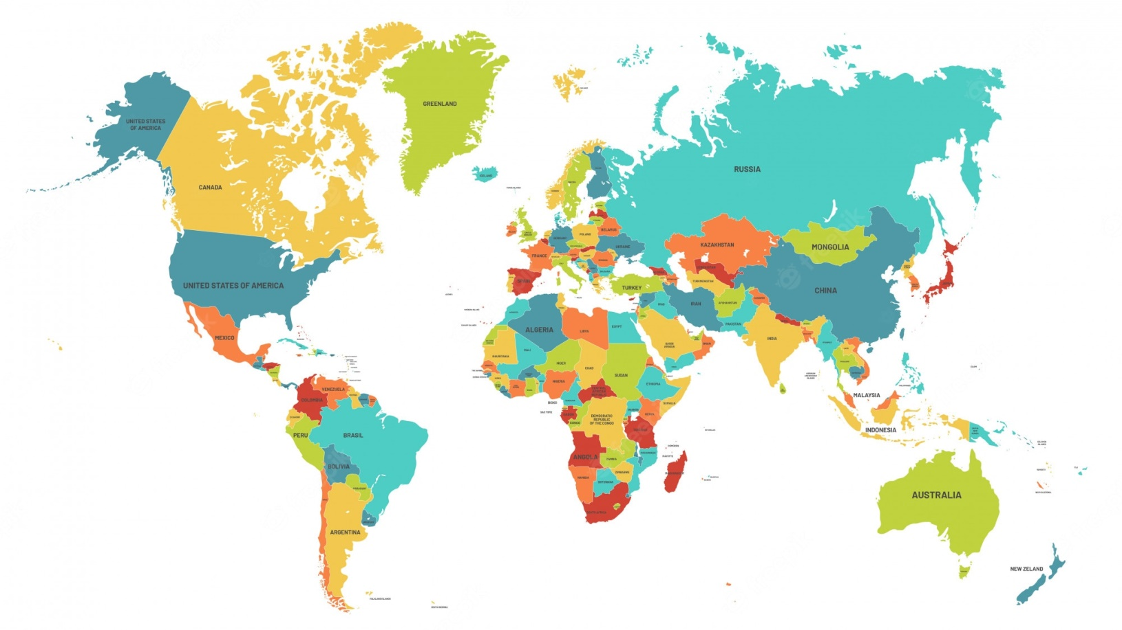
Who are the target customers?
Base case: Nigerian students, to gain experience
Students
Notes:
Base case: Nigerian students and LSUS, to gain experience
Segmentation:
Int'l students: Nigeria, countries with suitable markets, expand by country
US universities: Louisiana, surrounding states, expand state by state
Balanced approach
Students want choice in university Universities want extensive markets (more countries)

Slide 13
Customer Segmentation
Target Students: international with base case being students from Nigeria, typically age 16-33 (undergrad or grad studies), familiar with using technology such as web apps, adventurous or ambitious, may have a background with significant exposure to American cultures or have that desire

Slide 14
Market
Degree-granting institutions: 3,982*
Two-year: 1,303
Four-year: 2,679
Average student populations/university**
Total headcount: 6,300
International students: 4.6%
International headcount: 290
* National Center for Education Statistics, 2019-2020
** Pew Research Center

Slide 15
Pricing and Marketing
Price: $14.99 one-time payment
Marketing:
Facebook, Instagram, Google Ads, YouTube,
TikTok, and individually placed ads on websites frequently visited by international students

Slide 16
Objectives
One-year plan:
10,000 students
Again, we will localize with LSUS student connections and expand
Five-year plan:
100,000 students/year
Become the top app of choice for international students looking to study in the US

Slide 17
Goals: Connect driven, adventurous students with universities that will welcome them and provide the environment they need to succeed

Slide 18
Thank you!

